Slide 1
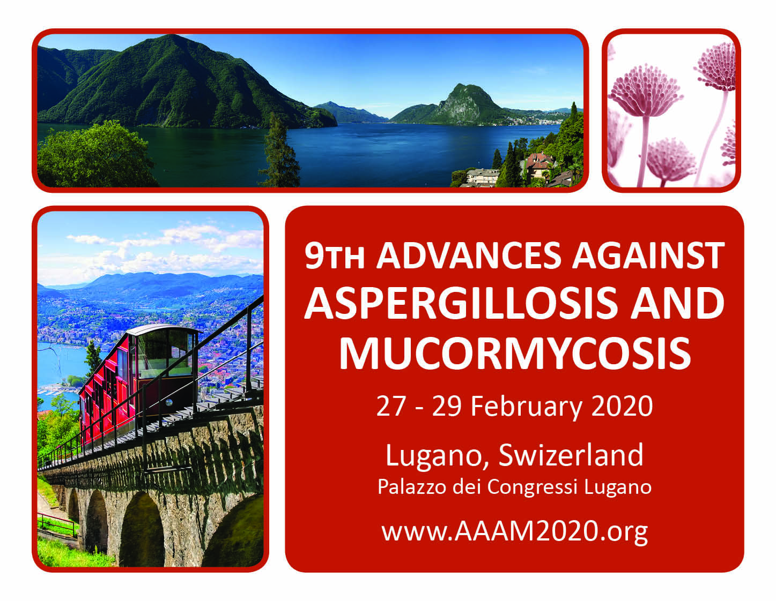

Slide 2

Q&A Session with Representatives from FDA and EMA
Moderators:
Professor Oliver A. Cornely MD, FACP, FIDSA, FAAM, FECMM
Professor Thomas F. Patterson MD, FACP, FIDSA

Slide 3
Areas of potential interest in antifungal drug development:
Invasive Aspergillosis (IA)
Chronic pulmonary Aspergillosis
Fungal asthma/Allergic bronchopulmonary Aspergillosis (ABPA)
Azole resistance
Influenza-associated IA
Mucormycosis
Pre-Clinical
Drug-drug interactions (DDI) with chemotherapy agents
Prophylaxis
Empiric therapy
Combination therapy

Slide 4
Format
Preset question(s) with minimal background
FDA response
EMA response
Questions and comments from the floor

Slide 5
Invasive Aspergillosis:
Diagnostic criteria
How can new diagnostics be incorporated into regulatory approval?
For example: Are new diagnostics equivalent for study enrollment to the established Platelia galactomannan (GM ELISA [Bio-Rad])
(such as the new galatomannoprotein [GP] ELISA [Eurolmmun], IMMY sōna Aspergillus Galactomannan Lateral Flow Assay [Asp GM LFA], or Aspergillus LFA [OLM Diagnostics])
If not, what criteria need to be met to establish equivalency?

Slide 6
Invasive Aspergillosis:
Outcome criteria
Can other markers of efficacy (e.g. surrogate markers) than All-Cause-Mortality (ACM) be used for non-inferiority or superiority studies?
  Can biomarkers be used for treatment discontinuation decisions/outcome assessments (such as GM, BDG, PCR, others?)
  What data are needed to establish surrogate endpoints?

Slide 7
Invasive Aspergillosis:
Outcome criteria
In situations with stable chest CT infiltrates, can alternative imaging such as PET-CT be used for treatment discontinuation decisions/outcome assessments?

Slide 8
Toxicity assessment:
Can additional markers (such as additional renal) be used for assessment (and comparison) of toxicity for new agents vs approved compounds?

Slide 9
Toxicity assessment:
Should DDI with agents likely to be used with a new antifungal agent be required prior to approval or specifically noted to not have been studied? (for example: mould active azoles and oral chemotherapeutic agents for leukemia such as FLT3 inhibitors, venetoclax, ibrutinib and others)

Slide 10
Invasive Aspergillosis (& Rare moulds!):
Study Design
Can non-indicated comparator agents be selected for IA (& RARE MOULDS--where there are limited [or no!] approved agents?)

Slide 11
Invasive Aspergillosis
First-line Treatment pivotal Non-Inferiority Clinical Trial
Choosing a control:
Are choices limited to the drugs approved for first-line treatment: voriconazole, isavuconazole, posaconazole (?) or amphotericin B?
Can an “investigator choice” approach be adopted? (acknowledging that a limited number of options is often advisable due to heterogeneity)
Would that response be difference for a Superiority trial?

Slide 12
Invasive Aspergillosis Drug development:
Enrollment criteria
The restriction of maximum use of prior antifungal therapy (typically no more than 3-4 days) seems short for IA, a condition that clearly needs several weeks of therapy. Is there a chance to relax this requirement? What could make sense from the medical point of view? 7 days?

Slide 13
Invasive Aspergillosis
Superiority
Statistical superiority for All-cause mortality (ACM) for new strategies, e.g. combination therapy, is likely not feasible, because of the sample size needed.
However, new strategies may achieve numerically improved survival plus other elements indicating improved response such as less time in ICU, on-schedule chemotherapy, etc.
Would the agency consider a more comprehensive approach to determine a superior therapeutic response, that may include numerically better survival plus other indicators of favorable outcome?

Slide 14
Invasive Aspergillosis
First-line Treatment Non-Inferiority Clinical Trial – New Populations
Many IA patients are not hem/SCT/SOT, but e.g. Influenza-Associated IA, other critically-ill patients, associated with new immune suppressive/modulatory agents (eg ibrutinib), etc.
How can these new populations be included in a pivotal non-inferiority efficacy clinical trial (& allowed with dx by biomarkers—GM/PCR?)
Is there a concern that the underlying disease may be different from previous IA RCT, such that the effect size estimate can not be made with confidence?
Is there a concern that these “new” groups may have a differential treatment effect.
Would that response be difference for a Superiority trial?

Slide 15
Rare Invasive Mould Infection/Mucormycosis
If the rare mold has innate/acquired drug resistance and has an incidence rate too low to conduct an RCT e.g. immunocompromised patients with serious fungal infections caused by Mucorales, Lomentospora prolificans, Scopulariopsis, documented azole-resistance in Aspergillus, etc.
How might uncontrolled data be sufficient for regulatory approval for the treatment of rare invasive mold infection?
Would a control group constructed from external data, e.g. literature or a registry, significantly add to the robustness of efficacy conclusions made from such uncontrolled study?
Would preclinical data vs. azole-resistant Aspergillus or other rare moulds provide supporting evidence?
Both?

Slide 16
Drug development
How does Limited Population Pathway for Antibacterial and Antifungal Drugs (LPAD) apply in the United States?
Could similar pathways be employed in rest of world/EU?

Slide 17
Drug development
Does the 2010 European Medicines Agency (EMA) antifungal guidance still apply or is it going to be updated?

Slide 18
Empiric Treatment
Evaluating antifungals for empiric use (e.g. in febrile neutropenia, etc.) is no longer favored by regulatory agencies, however a significant percentage of antifungal use in clinical practice is empirical.
Are the agencies concerned that currently approvable indications are not reflective of the most common use and as such the label information may not be fully informative for prescribers?
Is it time to revisit development programs for empiric use and generate guidelines around them?

Slide 19
Chronic Aspergillosis:
Outcome assessments
Which endpoints would be acceptable for new therapeutics for Allergic Broncho-Pulmonary Aspergillosis (ABPA) and Chronic Pulmonary Aspergillosis (CPA)?
-Clinical response?
-Radiological response?
-Serological response?
-Patient-reported responses?

Slide 20
Fungal asthma studies:
Outcome assessments
Which endpoints would be acceptable for new therapeutics for fungal asthma studies:
-Clinical response?
-Radiological response?
-Serological response?
-Patient-reported responses?

Slide 21
Novel approaches to antifungal approvals:
Could an antifungal be licensed for inhibiting a specific pathway instead of specific pathogens?? i.e. personalized/targeted treatments like we have in cancer therapeutics?

