Slide 1

NIH Funding Initiatives
Dona Love, PhD
Program Officer, NIAID
National Institutes of Health
Feb 28, 2020
9th Advances Against Aspergillosis and Mucormycosis

Slide 2
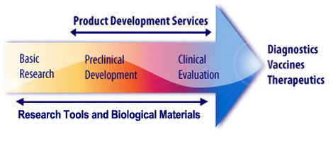
NIH funding initiatives
►Funding support /opportunities
►Preclinical services
►Questions

Slide 3
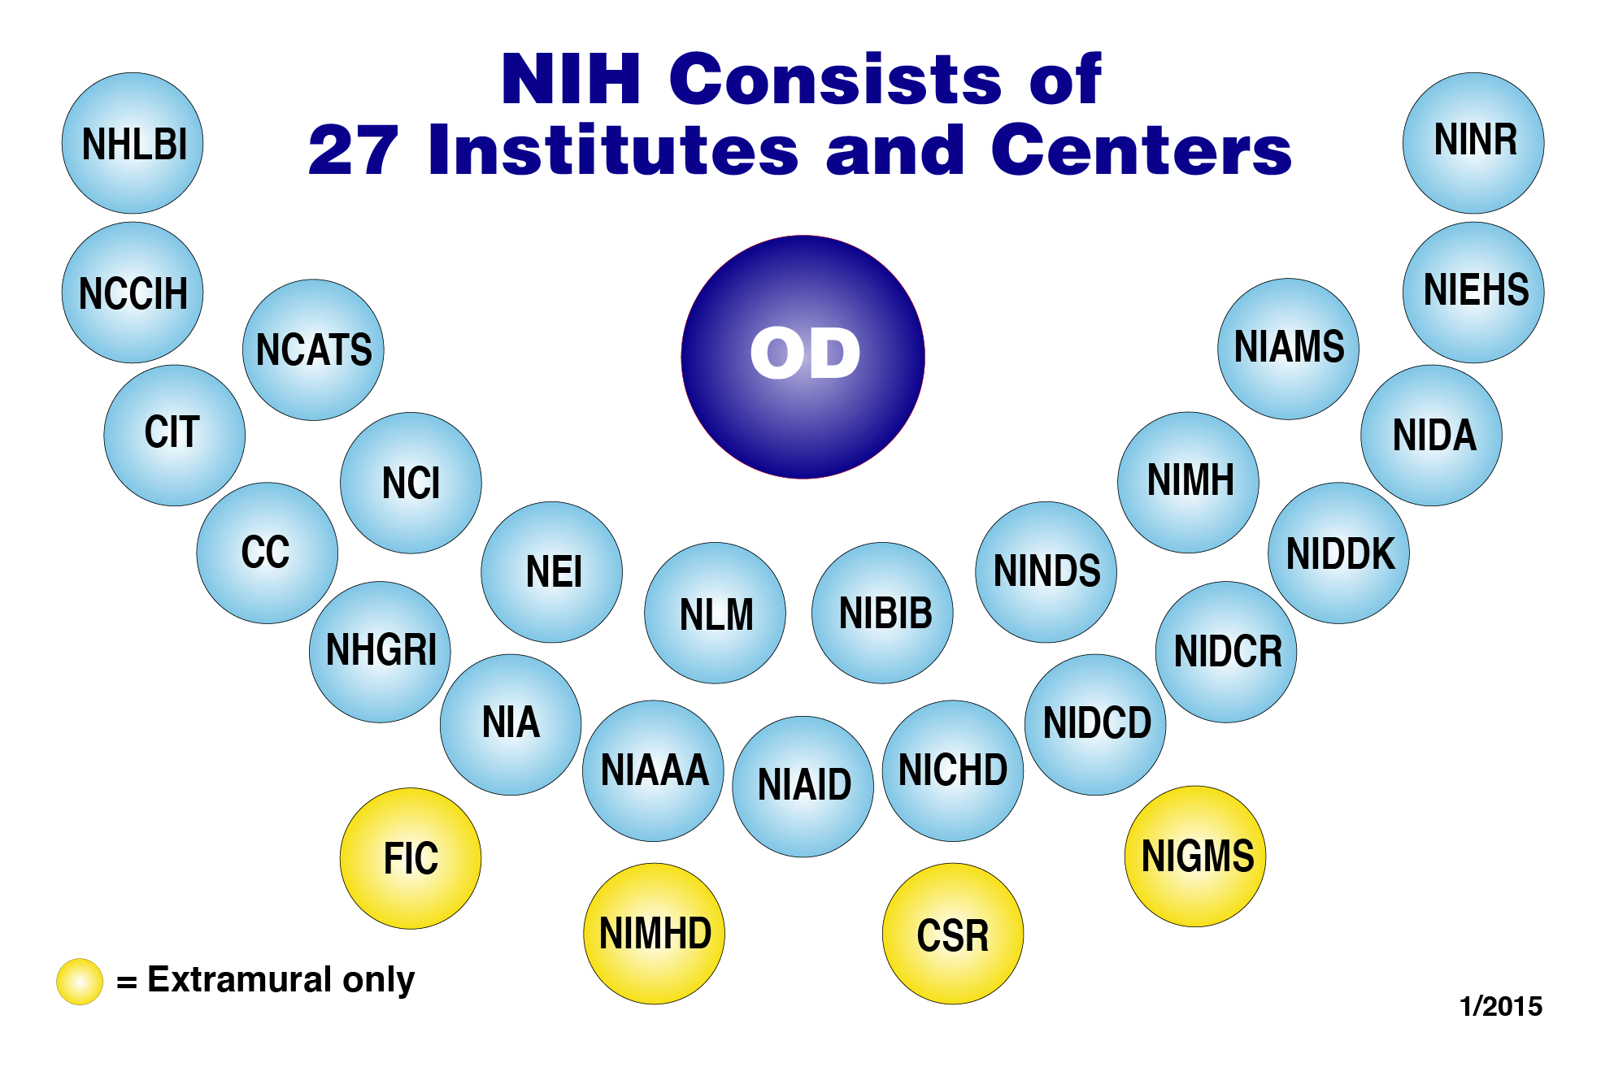
Fungal research across NIH
Active Grants
NIAID ~200
NIGMS ~40
NIDCR ~15
NHLBI ~8
NIDDK ~11

Slide 4
NIH Aspergillus & Zygomycete update
NIAID MISSION:
Leading research to understand, treat, and prevent infectious, immunologic, and allergic diseases

Slide 5
Fungal pathogens covered by NIH
~60 million/year DMID
~150 awards
~125 principal investigators
NIH RePORTER
projectreporter.nih.gov/reporter

Slide 6
Funding Opportunities
Apply for grants or contracts
--Grants—open to international researchers
  NIH-Wide Funding Opportunity Announcements
    R01, R21, R03 , R15, SBIR, STTR
  NIAID Funding Opportunity Announcements
    PA-19-081/082 (R21/R01) Advancing Development of Rapid Fungal Diagnostics
      Focused on therapeutics, vaccines, diagnostics
    PAR-20-108 (R01) International Research in Infectious Diseases (
      Investigators in low and middle resourced countries
--Contracts
  listings found at http://www.fedbizopps.gov
  NIAID BAA Omnibus 2020
    Focused on therapeutics, vaccines, diagnostics

Slide 7
NIH budget and paylines
NIAID FY 2020 budget—Final paylines
  R01 (non-new PIs) 14th percentile
  R01(new PIs) 18th percentile
  R21 31 overall impact score
  SBIR 34 overall impact score
--www.niaid.nih.gov/grants-contracts/niaid-paylines
--@NIAIDFunding
--donalove@nih.gov

Slide 8
Therapeutic Development Services
Interventional Agents
  therapeutics
  diagnostics
Biopharmaceutical Products
  monoclonal antibodies
  recombinant proteins
  siRNA
www.niaid.nih.gov/research/therapeutic-development-services

Slide 9
Therapeutic Development Services
Interventional Agents
  Lead Identification and Development
  Chemistry and Manufacturing
  In Vitro and In Vivo Preclinical Safety, Toxicology, and Pharmacokinetics
  Preclinical Development, Planning, and Evaluation
Biopharmaceutical Products
  Product development planning and evaluation
  Assay development and product release testing
  Process development and formulation
  GMP manufacturing
  Regulatory CMC documentation support

Slide 10
Therapeutic Development Services
In vitro Assessment for Antifungal Activity
  MIC testing
  Toxicity testing
Animal Models of Infectious Diseases
  Aspergillosis, Candidiasis, Mucormycosis, Coccidioidomycosis
  Efficacy, Dose tolerability, PK analysis
Phase 1 Clinical Trial Units for Therapeutics

Slide 11

NIH Funding Initiatives
Dona Love, PhD
donalove@nih.gov
Thank You!

